Slide 1
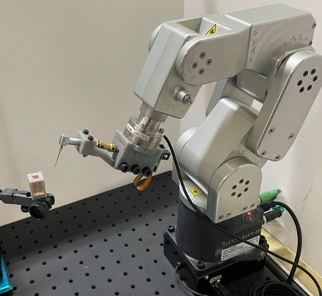
Robot-Assisted Endodontic Treatment
DentiBot
Presenter: Yi-Chan Li
Advisor: Prof. Cheng-Wei Chen
Next-generation Automated Surgical Apparatus Lab
06/15/2021

Slide 2
Outline
Motivation and Problem Definition
Previous Work
Proposed Method
Experimental Results
Discussion and Conclusion

Slide 3
Outline
Motivation and Problem Definition
Previous Work
Proposed Method
Experimental Results
Discussion and Conclusion

Slide 4
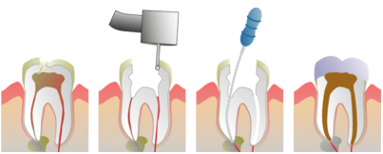
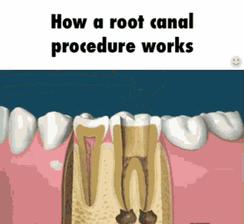



Endodontic Treatment
Opening
Cleaning
Filling
Repetitive movements
15,178 Dentists
238 Endodontists

Slide 5
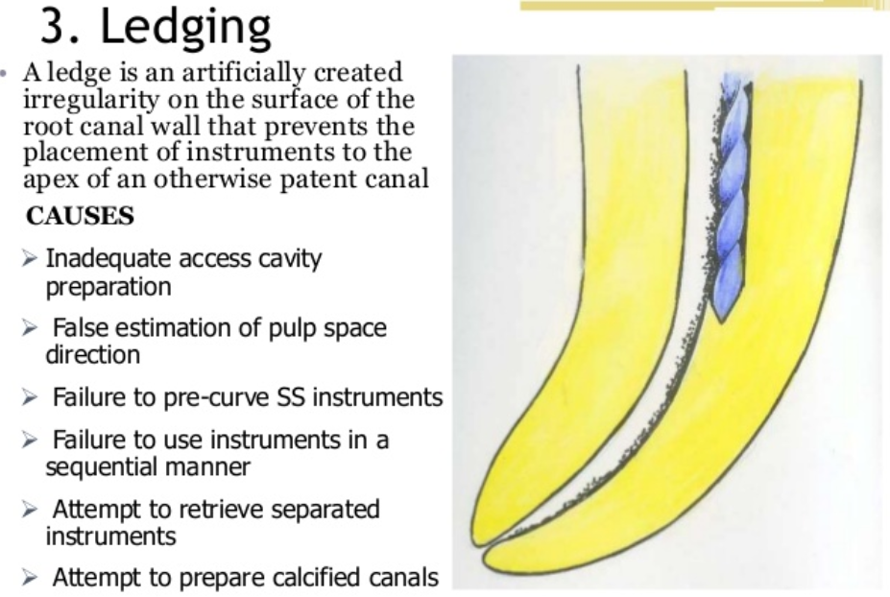
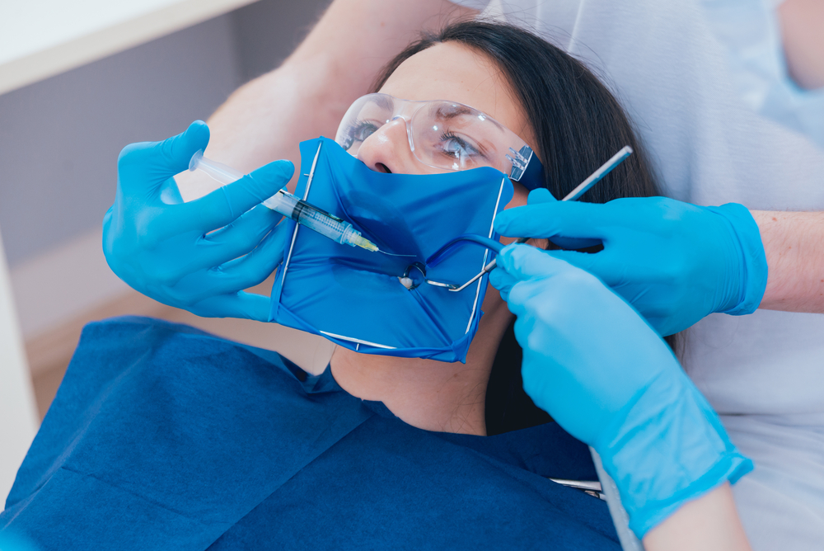
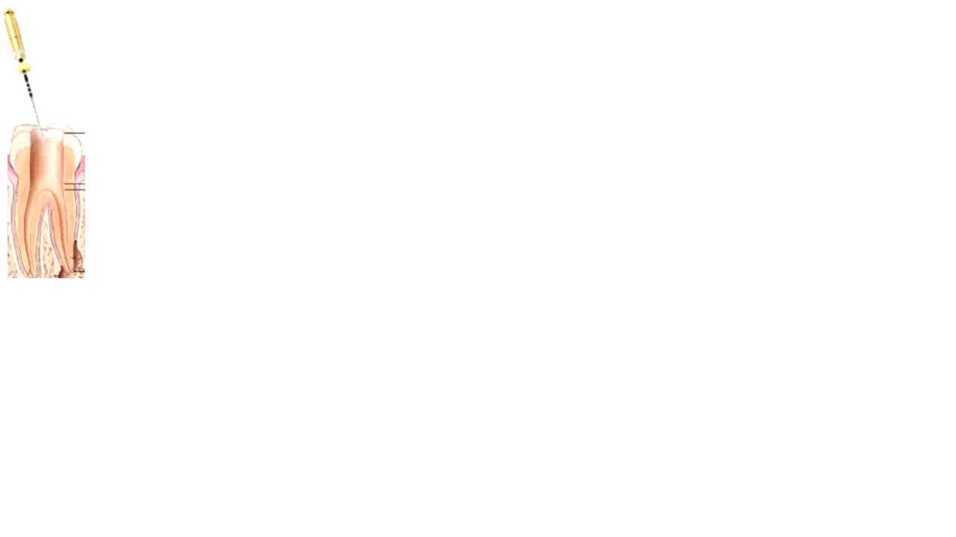
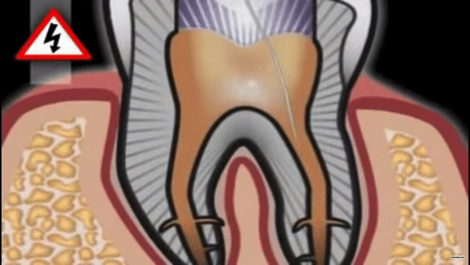
Challenges
Small
No real-time image
0.1 mm
Instrument fracture
Root canal direction
Notes:
https://riverparkdentalct.com/endodontics/

Slide 6
Problem Statement
1. How to assist dentists in performing “Cleaning” procedure?
2. How to align an unknown root canal direction?
3. How to protect the endodontic file from fracturing?
Notes:
\item \item \item

Slide 7
Outline
Motivation and Problem Definition
Previous Work
Proposed Method
Experimental Results
Discussion and Conclusion

Slide 8
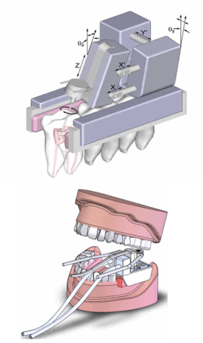
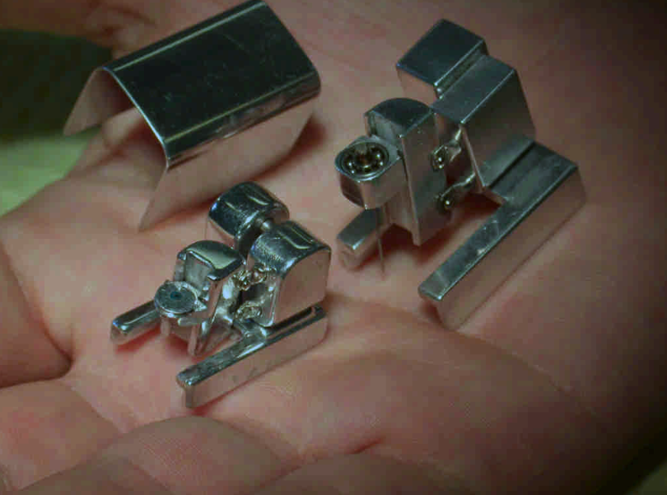
Endodontic Robot
Dong, J., Hong, S., & Hesselgren, G. (2006). WIP: a study on the development of endodontic micro robot. In Proceedings of the 2006 IJME-INTERTECH Conference.

Slide 9
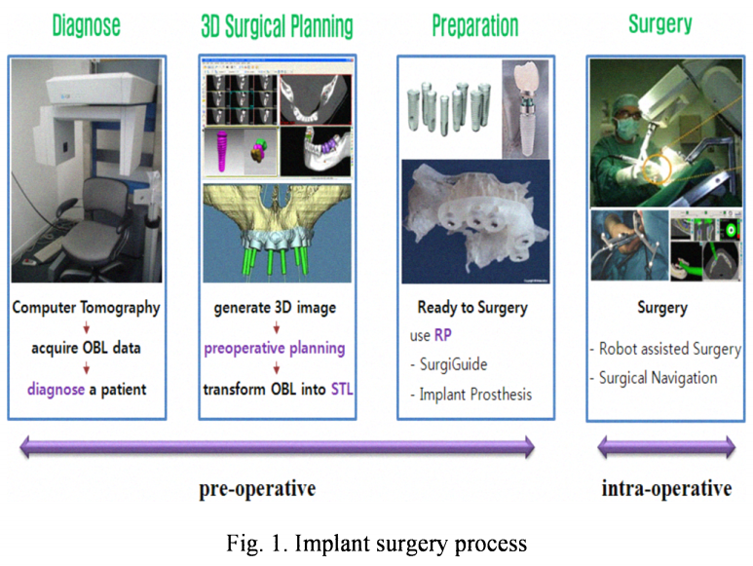
Endodontic Robot

Slide 10
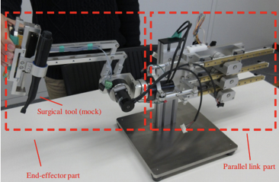
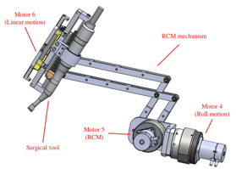
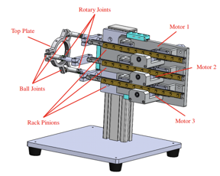
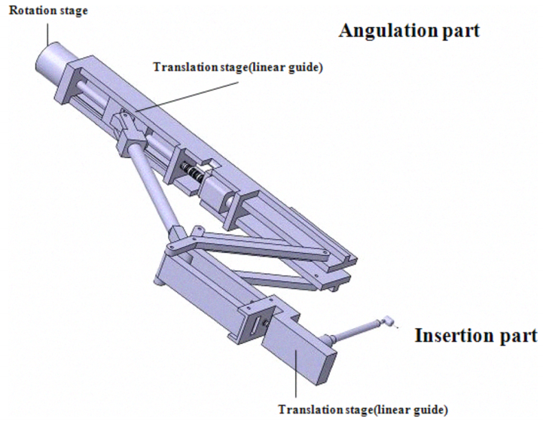
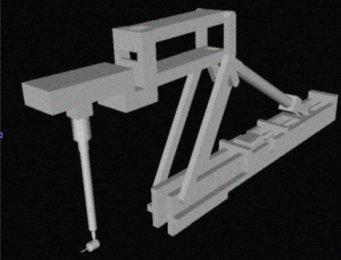
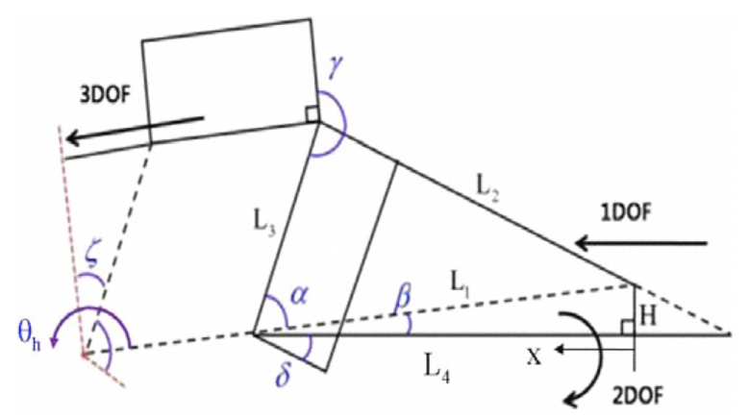
Other Dental Robots

Slide 11
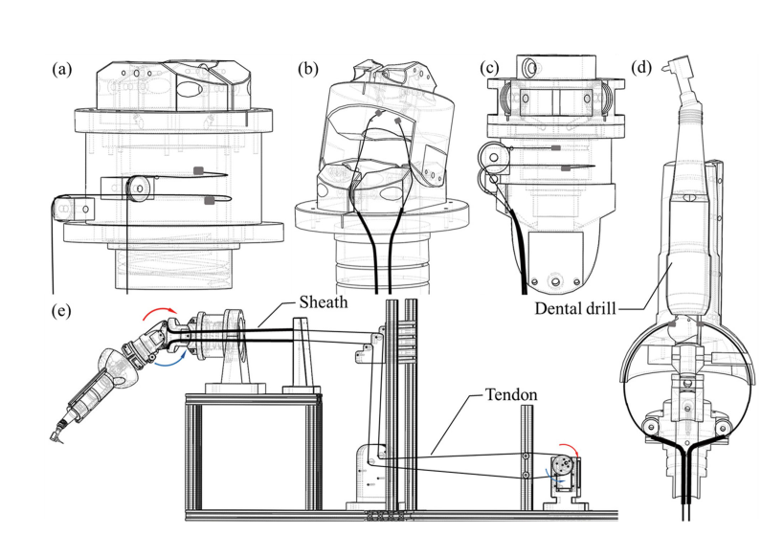
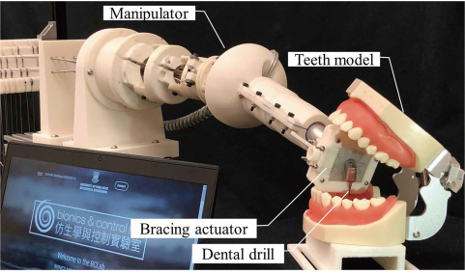
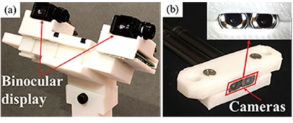
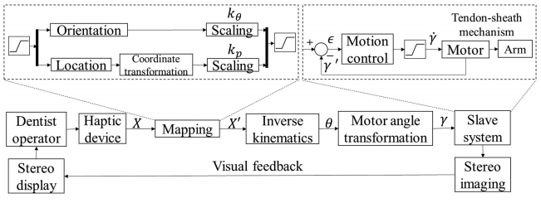
Other Dental Robots

Slide 12
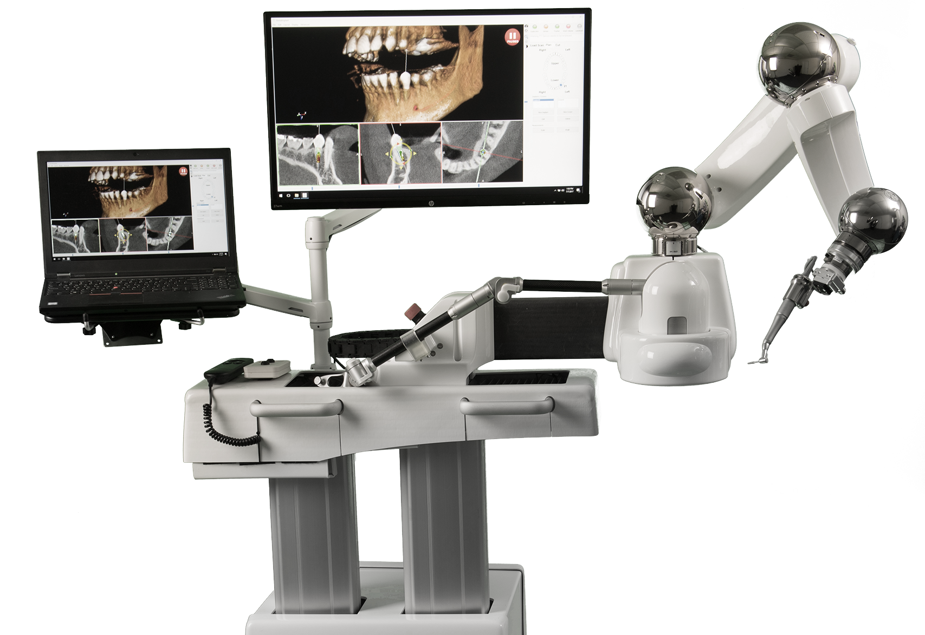
Commercial Dental Robot
Yomi Robotic System (Neocis Inc.)
surgical technology that assists dental implant surgery using 3D image of the patient.

Slide 13
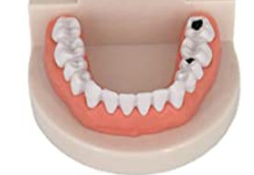
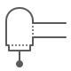
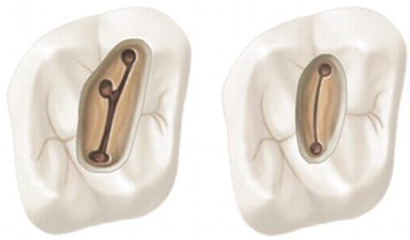
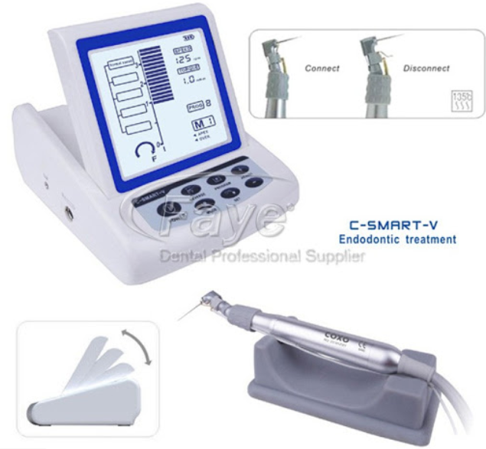
Prospect of DentiBot
1. Move to the infected teeth
2. Root canal searching
3. Repetitive drilling
4. Apex detection
Notes:
\item \item \item

Slide 14
Problem Statement
1. How to assist dentists in performing “Cleaning” procedure?
2. How to align an unknown root canal direction?
3. How to protect the endodontic file from fracturing?
Notes:
\item \item \item

Slide 15
Outline
Motivation and Problem Definition
Previous Work
Proposed Method
Experimental Results
Discussion and Conclusion

Slide 16



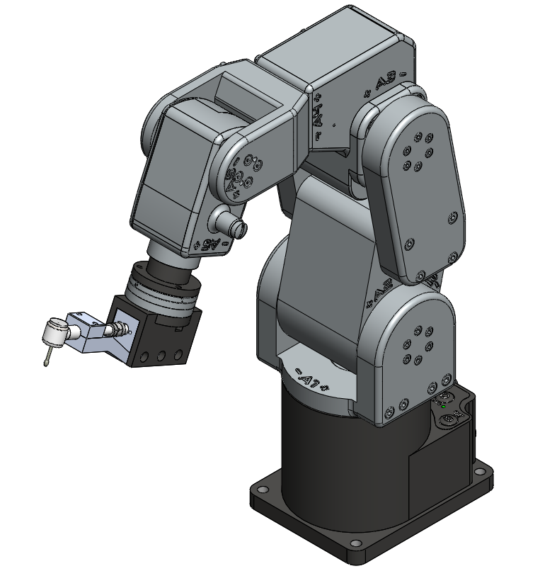
DentiBot
F/T Sensor
Modified
Handpiece
Robot Arm

Slide 17

System Integration
What problems should we solve?
Kinematics (Forward, Inverse, and Jacobian)
EtherCAT
Robot Arm
Gravity compensation
Reference frame changing
RTOS
F/T Sensor
Coordinate transformation
Translation Analysis - Tool Center Point
Rotation Analysis
Modified Handpiece

Slide 18
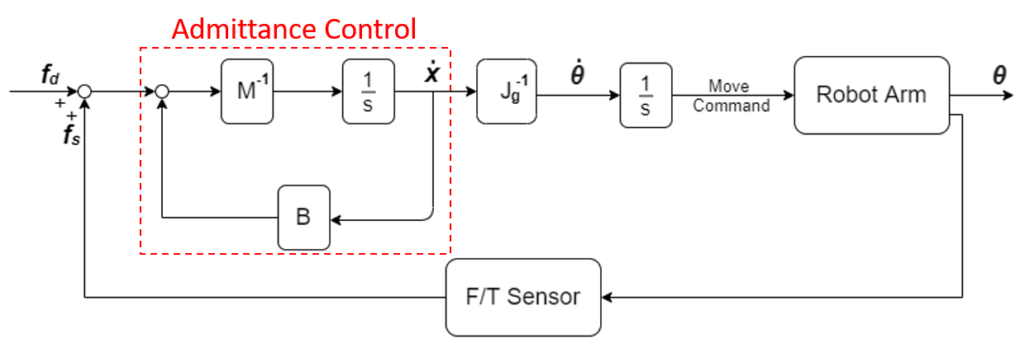
Control Scheme
Dragging Mode vs. Self-Alignment Mode
Notes:
Dragging mode

Slide 19
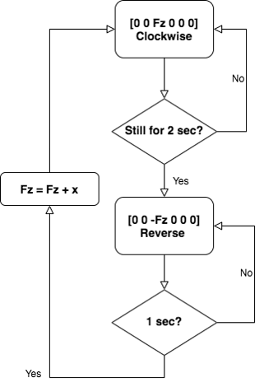
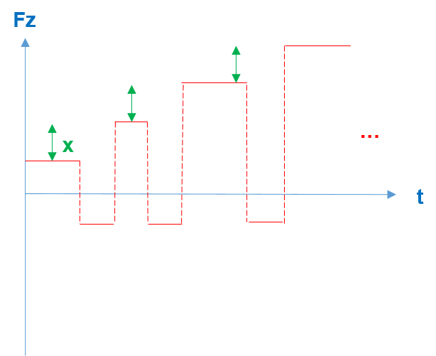
Motion Planning

Slide 20
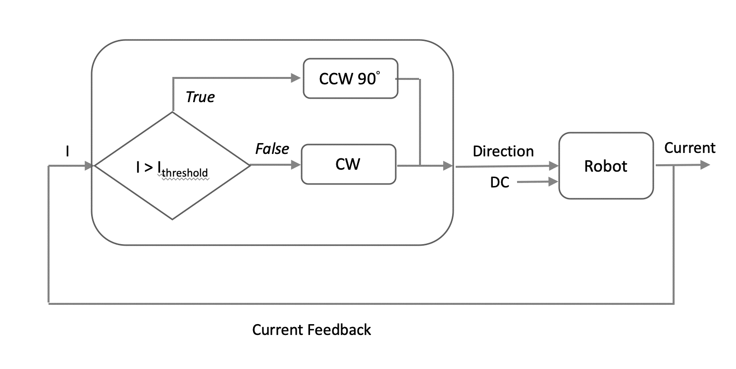
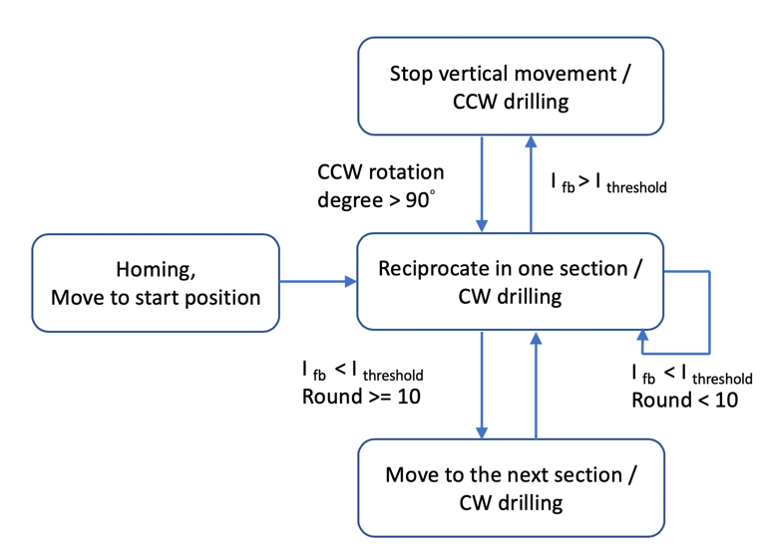
Instrument Protection
Two main causes of instrument fracture
1. Cyclic fatigue 70%
2. Torsional stress 30%
Solution:
Torque Sensing from Current Feedback
Driller

Slide 21
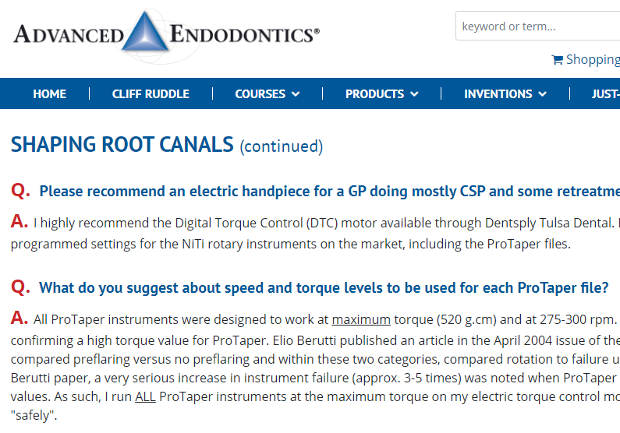
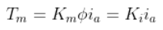
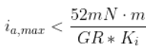
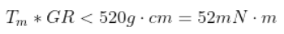
Instrument Protection
Screen shot from https://www.endoruddle.com/

Slide 22
Outline
Motivation and Problem Definition
Previous Work
Proposed Method
Experimental Results
Discussion and Conclusion

Slide 23
Video
Notes:
\item \item \item

Slide 24
Outline
Motivation and Problem Definition
Previous Work
Proposed Method
Experimental Results
Discussion and Conclusion

Slide 25
Main Contribution
Integrate a 6-DoF robotic manipulator with 6-DoF F/T sensor for performing endodontic treatment.
Develop a framework for robot alignment regarding the position and orientation of root canal.
Protect the endodontic file from fracturing by controlling file rotation speed.

Slide 26
Future Work
Discuss the feature of the endodontic file more deeply.
Patient tracking
Root canal searching
Apex detection

Slide 27
Thanks for your attention
Q & A

Slide 28
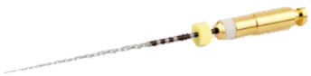
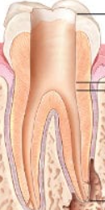
Preparation

